Slide 1
EECS 2500 Linear Data Structures
Lecture 19
Chapter 10 – Searching and Sorting – Part 4
Fall 2016
Dr. Larry G. Thomas – University of Toledo/LCCC

Slide 2
Last Time
Shellsort
An improvement on Insertion Sort
Performance is driven by interval sequences and # of passes
d₀ < N
d_{i+1} < d_{i}
1 ≤ nPass < N
d_{nPass-1} = 1

Slide 3
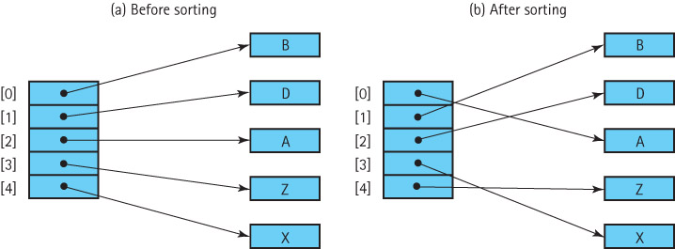
Concerns About Sorting Objects
When sorting an array of objects, remember we are manipulating references to the object, and not the objects themselves.

Slide 4
Using the Comparable Interface
For our sorted lists, we used objects that implemented Java’s Comparable interface.
The only requirement for Comparable is that it provides a compareTo operation.
A limitation of this approach is that a class can only have one compareTo method.
What if we have a class of objects, for example student records, that we want to sort in any of several various ways: by name, by grade, by zip code, in increasing order, in decreasing order?
In this case, we need to use the next approach.

Slide 5
Using the Comparator Interface
The Java Library provides another interface related to comparing objects called Comparator.
The interface defines two abstract methods:
public abstract int compare(T o1, T o2);
// Returns a negative integer, zero, or a positive integer
// to indicate that o1 is <, ==, or > than o2
public abstract boolean equals(T obj);
// Returns true if this Object equals obj; false, otherwise

Slide 6
Using the Comparator Interface
If we pass a Comparator object comp to a sorting method as a parameter, the method can use comp.compare to determine the relative order of two objects and base its sort on that relative order, rather than the objects’ compareTo
Passing a different Comparator object results in a different sorting order.
Now, with a single sorting method, we can produce many different sort orders.
Using a Comparator essentially allows us to let HOW to sort become a parameter

Slide 7
Example (1)
To allow us to concentrate on the topic of discussion, we use a simple circle class, with public instance variables:
public class SortCircle
{
public int xValue;
public int yValue;
public int radius;
public boolean solid;
}

Slide 8
Example (2)
Here is the definition of a Comparator object that orders SortCircles based on their xValue:
Comparator<Circle> xComp = new Comparator<Circle>()
{
public int compare(SortCircle a, SortCircle b)
{
return (a.xValue – b.xValue);
}
}
It should be obvious that we could write multiple comparators (yComp, rComp), each with different criteria (yValue, radius)

Slide 9
Example (3)
Here is a selectionSort method, along with its helper method minIndex, that accepts and uses a Comparator object
static int minIndex(int startIndex, int endIndex, Comparator<SortCircle> comp)
// Returns the index of the smallest value in values[startIndex]..values[endIndex].
{
int indexOfMin = startIndex;
for (int index = startIndex + 1; index <= endIndex; index++)
if (comp.compare(values[index],values[indexOfMin]) < 0)
indexOfMin = index;
return indexOfMin;
}
static void selectionSort(Comparator<SortCircle> comp)
// Sorts the values array using the selection sort algorithm.
{
int endIndex = SIZE – 1;
for (int current = 0; current < endIndex; current++)
swap(current, minIndex(current, endIndex, comp));
}

Slide 10
Stability of a Sorting Algorithm
Stable Sort: A sorting algorithm that preserves the relative order of duplicates in the input
Of the sorts that we have discussed in this book, only quickSort is inherently unstable (so is Shell, but it wasn’t in the book)
What does it matter?
Most of the time, it doesn’t – if all we want to do is put our list in order, stability is a non-issue
When we get into some of the even more advanced sorting methods in EECS 2510, stability will become a requirement.

Slide 11
Searching (§10.5)
We put things into lists so we can later retrieve them. Retrieving them requires finding them
In the case of a stack or a queue, we find them “when we’re supposed to” based on arrival time (FIFO/LIFO)
In this section we look at some of the basic “search by value” techniques for lists.
We’ve already seen some of these techniques: linear [O(n)] and binary search [O(lg N)]
In §10.6 we look at an advanced technique, called hashing, that can often provide O(1) searches by value.

Slide 12
Linear Searching
If we want to add elements as quickly as possible to a list, and we are not as concerned about how long it takes to find them we would put the element:
into the last slot in an array-based list
into the first slot in a linked list

Slide 13
Linear Searching (2)
To search this list for the element with a given key, we must use a simple linear (or sequential) search
Beginning with the first element in the list, we search for the desired element by examining each subsequent element’s key until either the search is successful or the list is exhausted.
The number of comparisons in this search is O(N)
Worst case: we have to make N key comparisons.
On the average, assuming that there is an equal probability of searching for any element in the list, we make N/2 comparisons for a successful search

Slide 14
High-Probability Ordering (1)
Sometimes certain list elements are in much greater demand than others. We can then improve the search:
Put the most-often-desired elements at the beginning of the list
Using this scheme, we are more likely to make a hit in the first few tries, and rarely do we have to search the whole list.

Slide 15
High-Probability Ordering (2)
If the elements in the list are not static or if we cannot predict their relative demand, we can:
move each element accessed to the front of the list or
as an element is found, it is swapped with the element that precedes it (increment its importance or “firstness”)
Lists in which the relative positions of the elements are changed in an attempt to improve search efficiency are called self-organizing or self-adjusting lists.

Slide 16
Sorted Lists
If the list is sorted, a sequential search no longer needs to search the whole list to discover that an element does not exist. It only needs to search until it has passed the element’s logical place in the list – a that is, until an element with a larger key value is encountered.
Another advantage of linear searching is its simplicity.
The binary search is usually faster; however, it is not guaranteed to be faster for searching very small lists, and can’t be used at all on linked lists

Slide 17
Sorted Lists (2)
As the number of elements increases, however, the disparity between the linear search and the binary search grows very quickly.
The binary search is appropriate only for list elements stored in a sequential array-based representation.
However, a binary search tree (EECS 2510) allows us to perform a binary search on a linked data representation

Slide 18
Hashing (§10.6)
The idea behind hashing is that the value itself tells us (more or less immediately) where to:
A) Store the item when we first see it
B) Look for it when we want to retrieve it
WITHOUT having to linear- or binary-search the list
HOW?
Before we continue, if you’ve ever downloaded a large file, and wanted to make sure it downloaded without error, you might also download a hash of the file and use a program to generate a hash of the file as-received. If the two match, the file downloaded OK
This kind of hash has nothing to do with hash tables!

Slide 19
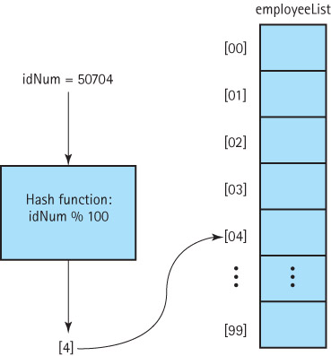
Hashing (§10.6)

Slide 20
Definitions
Hash Function: A function used to manipulate the key of an element in a list to identify its location in the list
Hashing: The technique for ordering and accessing elements in a list in a relatively constant amount of time by manipulating the key to identify its location in the list
Hash table: The data structure used to store and retrieve elements using hashing
Hash Table Loading: The percentage of possible space in a hash table actually being used

Slide 21
Our Hashable Interface
public interface Hashable
{
// Objects of classes that implement this interface // can be used with lists based on hashing.
int hash();
// hash() is a mathematical function used to manipulate
// the key of an element in a list to identify its location
// in the list.
//
}

Slide 22
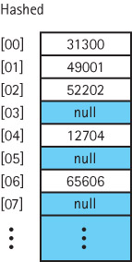
Using the hash Method
public void add (Hashable element)
{
// Adds element to this list at position element.hash()
//
int location;
location = element.hash();
list[location] = element;
numElements++;
}
public Hashable get(Hashable element)
{
// Returns an element e from this list such that
// e.equals(element).
int location;
location = element.hash();
return (Hashable)list[location];
}

Slide 23
Collisions
Collision: The condition resulting when two or more keys produce the same hash location
The lower the hash table loading, the less likely collisions are
Lower hash table loading means we over-allocated the table, and we’re wasting space
Hash tables are a tradeoff between avoiding collisions and wasting space
Linear probing: One way to resolve a hash collision is by sequentially searching a hash table beginning at the location returned by the hash function
If the key hashes to location 100, and 100 is occupied, try 101, 102, etc.

Slide 24
Revised Methods
public static void add (Hashable element)
{
// Adds element to this list at position element.hash(), or the next free array slot.
int location;
location = element.hash();
while (list[location] != null)
location = (location + 1) % list.length;
list[location] = element;
numElements++;
}
public static Hashable get(Hashable element)
{
// Returns an element e from this list such that e.equals(element).
int location;
location = element.hash();
while (!list[location].equals(element))
location = (location + 1) % list.length;
return (Hashable)list[location];
}

Slide 25
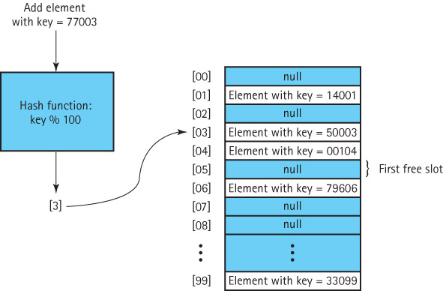
Handling Collisions w/ Linear Probing

Slide 26
Removing An Element (1)
One (naïve) approach might be:
remove (element)
{
Set location to element.hash( )
Set list[location] to null
}

Slide 27
Removing An Element (2)
Collisions, however, complicate the matter. We cannot be sure that our element is what’s in location element.hash()
We must examine every array element, starting with location element.hash(), until we find the matching element.
We cannot stop looking when we reach an empty location, because that location may represent an element that was previously removed.
This problem illustrates that hash tables, in the forms that we have studied thus far, are not the most effective data structure for implementing lists whose elements may be deleted.

Slide 28
More Considerations
Clustering: The tendency of elements to become unevenly distributed in the hash table, with many elements clustering around a single hash location
Rehashing: Resolving a collision by computing a new hash location from a hash function that manipulates the original location rather than the element’s key
Quadratic probing: Resolving a hash collision via the rehashing formula (HashVal ± i²) % array-size
Quadratic probing helps spread out clusters
Random probing: Resolving collisions by generating pseudo-random hash values in successive applications of the rehash function

Slide 29
Buckets and Chaining
Bucket: A collection of elements associated with a particular hash location
Chain: A linked list of elements that share the same hash location
Chaining essentially allows several colliding items to occupy the “same” bucket
We want to keep the chains short, or it degenerates into a linear search again!

Slide 30
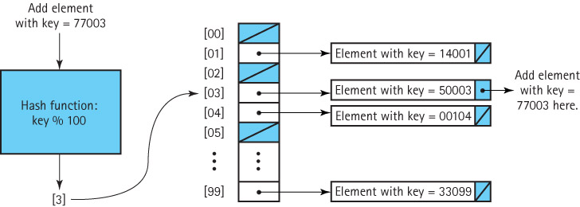
Handling Collisions with Chaining

Slide 31
Java’s Support for Hashing (1)
The Java Library includes a HashTable class that uses hash techniques to support storing objects in a hash table.
The library includes several other collection classes, such as HashSet, that provide an ADT whose underlying implementation uses the approaches described in this section.
The Java Object class exports a hashCode method that returns an int hash code. Therefore all Java objects already have an associated hash code.
The standard Java hash code for an object is a function of the object’s memory location.

Slide 32
Java’s Support for Hashing (2)
For most applications, hash codes based on memory locations are not usable. Therefore, many of the Java classes that define commonly used objects (such as String and Integer), override the Object class’s hashCode method with one that is based on the contents of the object.
If you plan to use hash tables in your programs, you should do likewise.

Slide 33
Your Next Programming Project
Since this chapter is all about searching and sorting, and your last project (comparing the performance of the various linked lists used for storage and retrieval), it makes sense to add a hashing component to that project
This project has you implement two new lists that use hashing to (hopefully) speed up the unsorted list
The two new lists differ only in their hash function.
You can’t use any of Java’s built-in hashing functionality – write your own
See Blackboard

Slide 34
End of Chapter 10
? Questions ?

